Slide 1

Echelon Institute of Technology
Depression Detection
Submitted By : Vidushi Gandhi
Rollno :20-CSE-58
University Roll no : 20015004058
Semester : 6

Slide 2
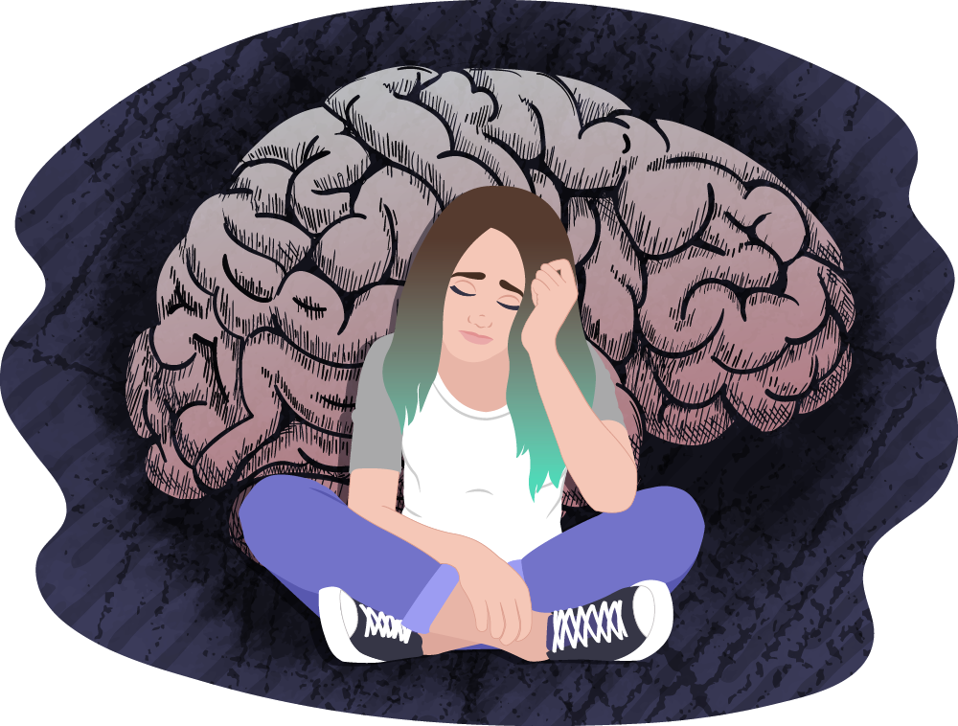
Overview
Introduction
Technology Used
Hardware and Software Requirements
Python Library
WorkFlow Diagram
Benefits
Screen Shots
Conclusion & Future Scope
References
Thank You

Slide 3

Introduction
Depression (major depressive disorder) is a common and serious medical illness that negatively affects how you feel, the way you think and how you act. Fortunately, it is also treatable. Depression causes feelings of sadness and/or a loss of interest in activities you once enjoyed. It can lead to a variety of emotional and physical problems and can decrease your ability to function at work and at home.

Slide 4

Technology Used

Slide 5
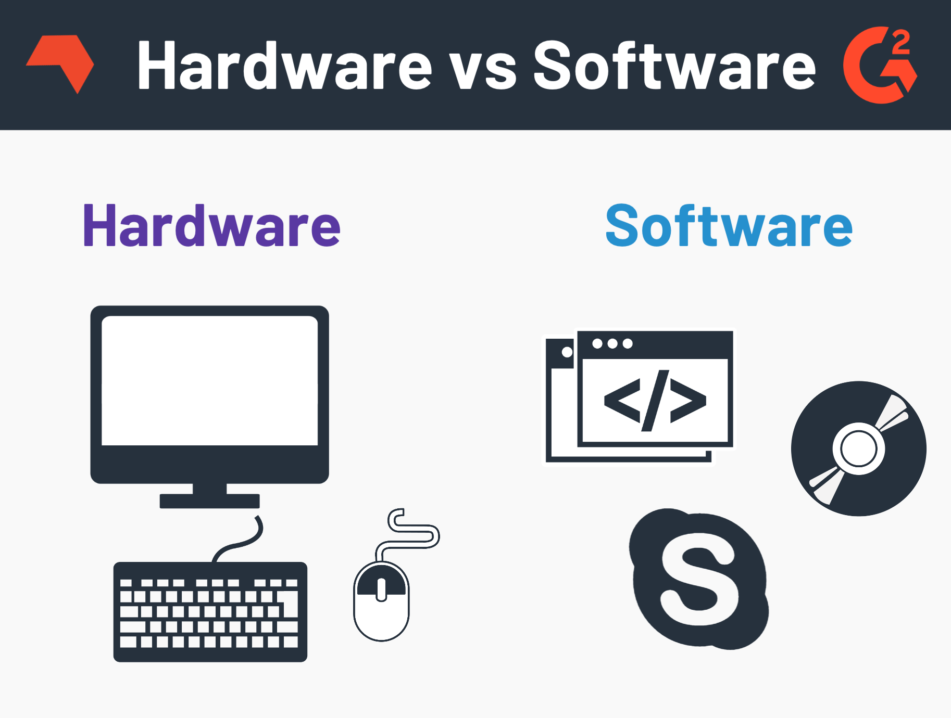
Hardware and Software Requirements
•At least Windows 10
•64-bit operating system
•Jupyter
•Internet Connectivity

Slide 6
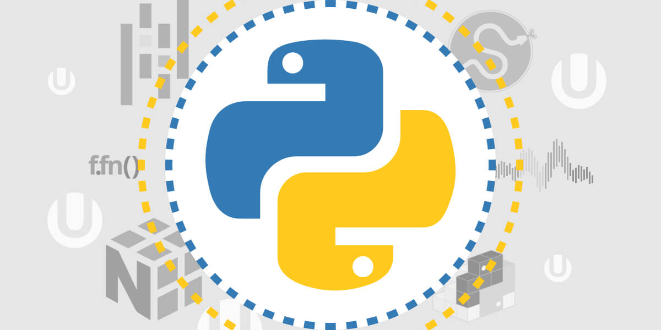
Python Library
o Pandas
o NLP
o NLTK
o Multinomial Naive Bayes
o Gaussian Naive Bayes
o Numpy

Slide 7
WorkFlow Diagram
DataSet Collection
Data preprocessing
Data Partitioning
ML Algorithm
Result Analysis
Predictions

Slide 8
Benefits
Identifying a mental health disorder early can slow its progress
Addressing depression can improve a person’s physical health
By acknowledging the problem, helpful treatments can begin
Anyone can experience depression at any point in life
Social stigma surrounding mental illnesses discourages people from getting help
Mental health conditions like depression can lead to drug and alcohol abuse
Untreated depression can lead to suicide

Slide 9
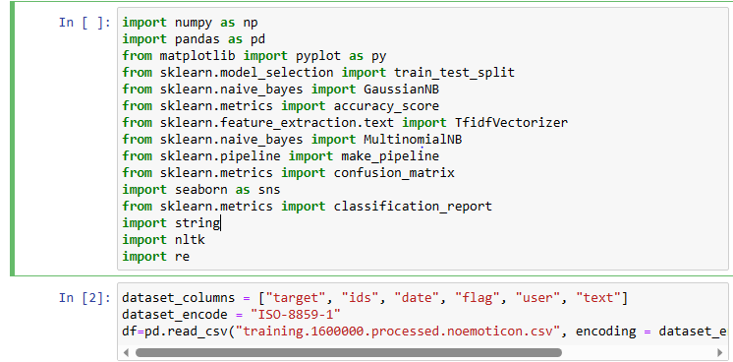
Screenshots

Slide 10
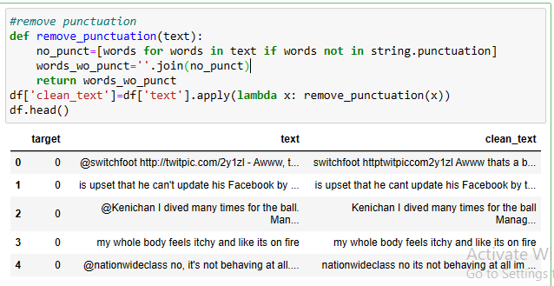
Screenshots

Slide 11
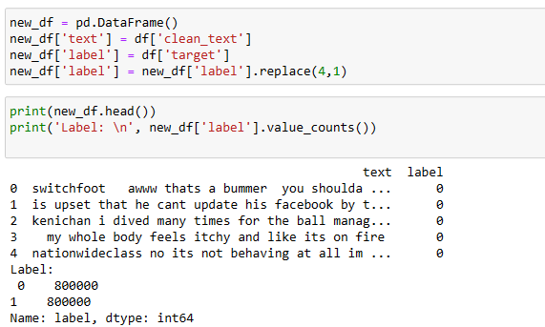
Screenshots

Slide 12
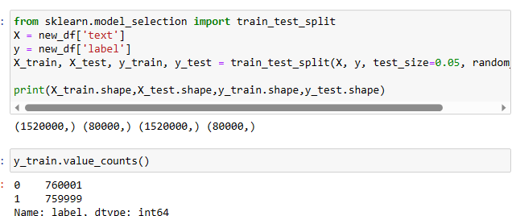
Screenshots

Slide 13
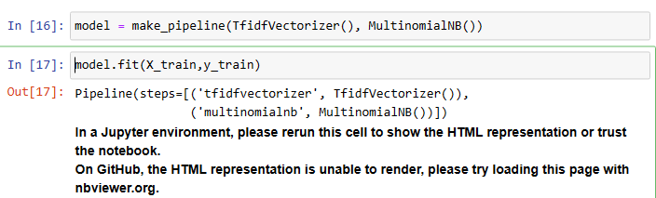
Screenshots

Slide 14
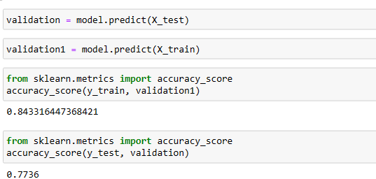
Screenshots

Slide 15
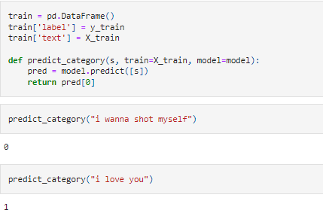
Screenshots

Slide 16
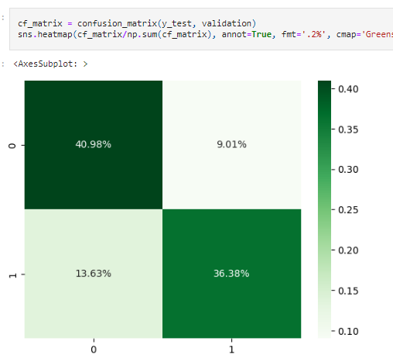
Screenshots

Slide 17
Conclusion & Future Scope
The objective of this project was to detect Depression using sentiment Analysis.
For this purpose, a dataset was collected from the Kaggle . It was pre-processed and clean to prepare it for further use. Then the dataset was split into 80%-20% partitions for Training and Testing respectively. Further, popular ML algorithms, Naive Bayes . The results obtained after experiments show that the Naive Bayes technique resulted in a classification accuracy of more than 84%.
As a future work in this research, other Machine Learning techniques and Deep Learning techniques can be applied for better prediction accuracy. Moreover, a dataset consisting of many instances can be collected and used for performing experiments.

Slide 18

References
Orabi, A. H., Buddhitha, P., Orabi, M. H., & Inkpen, D. (2018, June). Deep learning for depression detection of twitter users. In Proceedings of the fifth workshop on computational linguistics and clinical psychology: from keyboard to clinic (pp. 88-97).
Islam, M. R., Kabir, M. A., Ahmed, A., Kamal, A. R. M., Wang, H., & Ulhaq, A. (2018). Depression detection from social network data using machine learning techniques. Health information science and systems, 6, 1-12.
Chiong, R., Budhi, G. S., Dhakal, S., & Chiong, F. (2021). A textual-based featuring approach for depression detection using machine learning classifiers and social media texts. Computers in Biology and Medicine, 135, 104499.

Slide 19
Thank You

